Slide 1
DISTRIBUTED COORDINATION FUNCTION
- Prabhu Tiwari
- 35

Slide 2
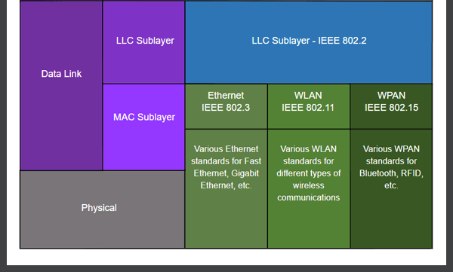

Slide 3
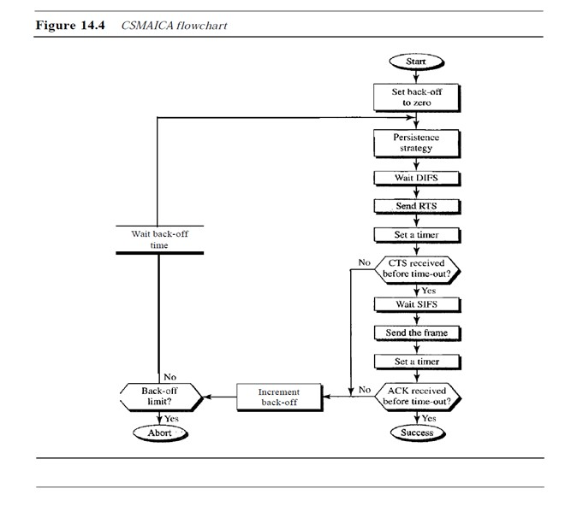
DIFS- DISTRIBUTED INTERFRAME SPACE
RTS- REQUEST TO SEND
CTS- CLEAR TO SEND
SIFS- SHORT INTERFRAME SPACE
*back off : random number from 0 to 2^(k-1)

Slide 4


